Slide 1
Concurrency Control

Slide 2
Lock-Based Protocols
A lock is a mechanism to control concurrent access to a data item
Data items can be locked in two modes :
1. exclusive (X) mode
Data item can be both read as well as written
X-lock is requested using lock-X instruction
2. shared (S) mode
Data item can only be read. S-lock is requested using lock-S instruction.
Lock requests are made to concurrency-control manager
Transaction can proceed only after request is granted

Slide 3
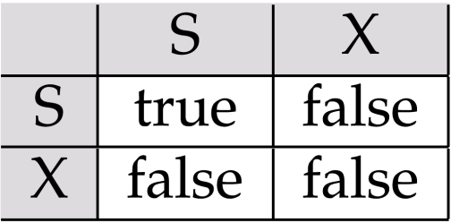
Lock-Based Protocols (Cont.)
Lock-compatibility matrix
A transaction may be granted a lock on an item if the requested lock is compatible with locks already held on the item by other transactions
Any number of transactions can hold shared locks on an item,
but if any transaction holds an exclusive on the item no other transaction may hold any lock on the item.
If a lock cannot be granted, the requesting transaction is made to wait till all incompatible locks held by other transactions have been released. The lock is then granted.

Slide 4
Example
Example of a transaction performing locking:
T₁: lock-X(B);
read (B);
B:=B - 50;
write (B);
unlock(B);
lock-X(A);
read (A);
A:=A + 50;
unlock(A);

Slide 5
Lock-Based Protocols (Cont.)
Example of a transaction performing locking:
T₂: lock-S(A);
read (A);
unlock(A);
lock-S(B);
read (B);
unlock(B);
display(A+B)
Locking as above is not sufficient to guarantee serializability — if A and B get updated in-between the read of A and B, the displayed sum would be wrong.
A locking protocol is a set of rules followed by all transactions while requesting and releasing locks
Locking protocols restrict the set of possible schedules

Slide 6
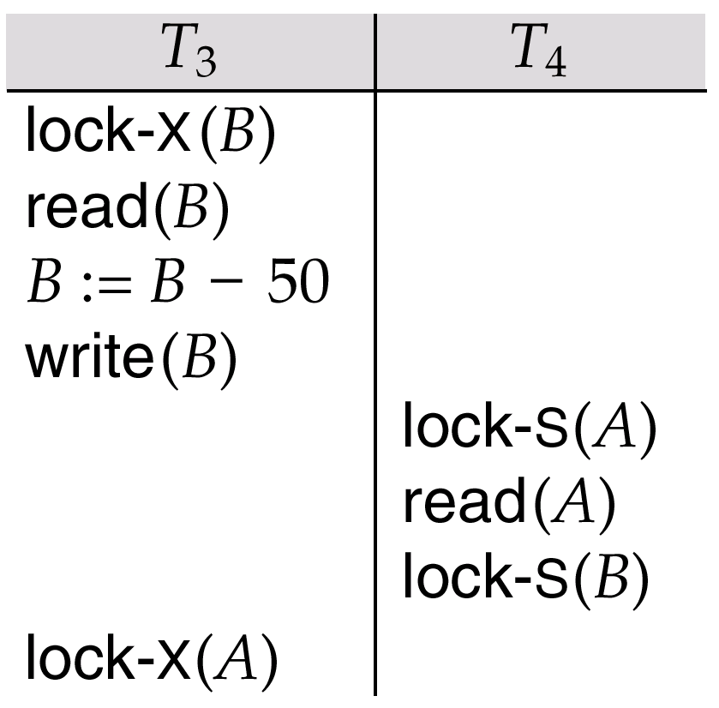
Pitfalls of Lock-Based Protocols
Consider the partial schedule
Neither T₃ nor T₄ can make progress — executing lock-S(B) causes T₄ to wait for T₃ to release its lock on B, while executing lock-X(A) causes T₃ to wait for T₄ to release its lock on A.
Such a situation is called a deadlock.
To handle a deadlock one of T₃ or T₄ must be rolled back and its locks released

Slide 7
Pitfalls of Lock-Based Protocols Cont.)
The potential for deadlock exists in most locking protocols
Starvation is also possible if concurrency control manager is badly designed. For example:
A transaction may be waiting for an X-lock on an item, while a sequence of other transactions request and are granted an S-lock on the same item
The same transaction is repeatedly rolled back due to deadlocks
Concurrency control manager can be designed to prevent starvation

Slide 8
The Two-Phase Locking Protocol
This is a protocol which ensures conflict-serializable schedules.
Phase 1: Growing Phase
transaction may obtain locks
transaction may not release locks
Phase 2: Shrinking Phase
transaction may release locks
transaction may not obtain locks
The protocol assures serializability
It can be proved that the transactions can be serialized in the order of their lock points (i.e. the point where a transaction acquired its final lock).

Slide 9
Example
Example of a transaction performing locking:
T₃: lock-X(B);
read (B);
B:=B - 50;
write (B);
lock-X(A);
read (A);
A:=A + 50;
unlock(B);
unlock(A);

Slide 10
Example
T₂: lock-S(A);
read (A);
lock-S(B);
read (B);
display(A+B);
unlock(A);
unlock(B);

Slide 11
The Two-Phase Locking Protocol (Cont.)
Two-phase locking does not ensure freedom from deadlocks
Cascading roll-back is possible under two-phase locking.
To avoid this, follow a modified protocol called strict two-phase locking. Here a transaction must hold all its exclusive locks till it commits/aborts.
Rigorous two-phase locking is even stricter: here all locks are held till commit/abort. In this protocol transactions can be serialized in the order in which they commit.

Slide 12
The Two-Phase Locking Protocol (Cont.)
T₁:
read(a1);
read (a2);
……..
read (an);
write(a1);
T₂:
read (a1);
read (a2);
display(a1+ a2);

Slide 13
Lock Conversions
Two-phase locking with lock conversions:
– First Phase:
can acquire a lock-S on item
can acquire a lock-X on item
can convert a lock-S to a lock-X (upgrade)
– Second Phase:
can release a lock-S
can release a lock-X
can convert a lock-X to a lock-S (downgrade)
This protocol assures serializability. But still relies on the programmer to insert the various locking instructions.

Slide 14
Implementation of Locking
A lock manager can be implemented as a separate process to which transactions send lock and unlock requests
The lock manager replies to a lock request by sending a lock grant messages (or a message asking the transaction to roll back, in case of a deadlock)
The requesting transaction waits until its request is answered
The lock manager maintains a data-structure called a lock table to record granted locks and pending requests
The lock table is usually implemented as an in-memory hash table indexed on the name of the data item being locked

Slide 15
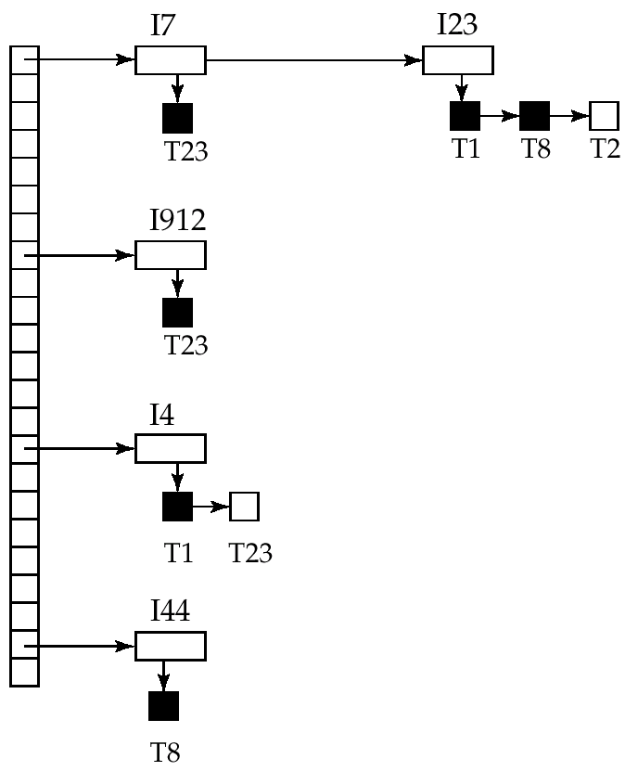
Lock Table
Black rectangles indicate granted locks, white ones indicate waiting requests
Lock table also records the type of lock granted or requested
New request is added to the end of the queue of requests for the data item, and granted if it is compatible with all earlier locks
Unlock requests result in the request being deleted, and later requests are checked to see if they can now be granted
If transaction aborts, all waiting or granted requests of the transaction are deleted
lock manager may keep a list of locks held by each transaction, to implement this efficiently
Granted
Waiting

Slide 16
Graph-Based Protocols
Graph-based protocols are an alternative to two-phase locking
Impose a partial ordering → on the set D = {d₁, d₂ ,..., d_{h}} of all data items.
If d_{i} → d_{j} then any transaction accessing both d_{i} and d_{j} must access d_{i} before accessing d_{j}.
Implies that the set D may now be viewed as a directed acyclic graph, called a database graph.
The tree-protocol is a simple kind of graph protocol.

Slide 17
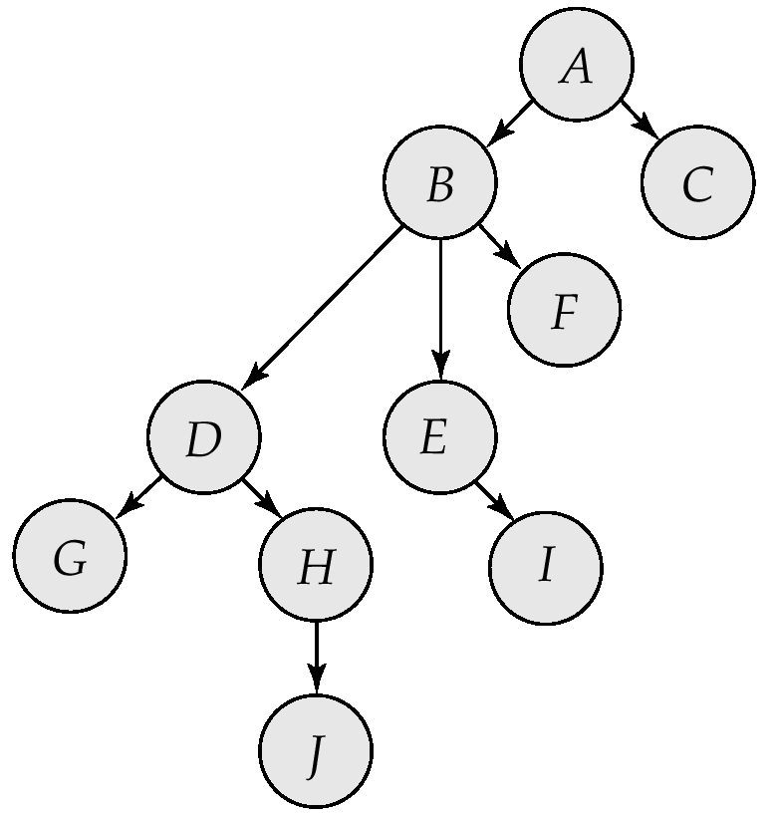
Tree Protocol
Only exclusive locks are allowed.
The first lock by T_{i} may be on any data item. Subsequently, a data Q can be locked by T_{i} only if the parent of Q is currently locked by T_{i}.
Data items may be unlocked at any time.
A data item that has been locked and unlocked by T_{i} cannot subsequently be relocked by T_{i}

Slide 18
Graph-Based Protocols (Cont.)
The tree protocol ensures conflict serializability as well as freedom from deadlock.
Unlocking may occur earlier in the tree-locking protocol than in the two-phase locking protocol.
shorter waiting times, and increase in concurrency
protocol is deadlock-free, no rollbacks are required
Drawbacks
Protocol does not guarantee recoverability or cascade freedom
Need to introduce commit dependencies to ensure recoverability
Transactions may have to lock data items that they do not access.
increased locking overhead, and additional waiting time
potential decrease in concurrency
Schedules not possible under two-phase locking are possible under tree protocol, and vice versa.

Slide 19
Multiple Granularity
Allow data items to be of various sizes and define a hierarchy of data granularities, where the small granularities are nested within larger ones
Can be represented graphically as a tree (but don't confuse with tree-locking protocol)
When a transaction locks a node in the tree explicitly, it implicitly locks all the node's descendents in the same lock mode
Granularity of locking (level in tree where locking is done):
fine granularity (lower in tree): high concurrency, high locking overhead
coarse granularity (higher in tree): low locking overhead, low concurrency

Slide 20
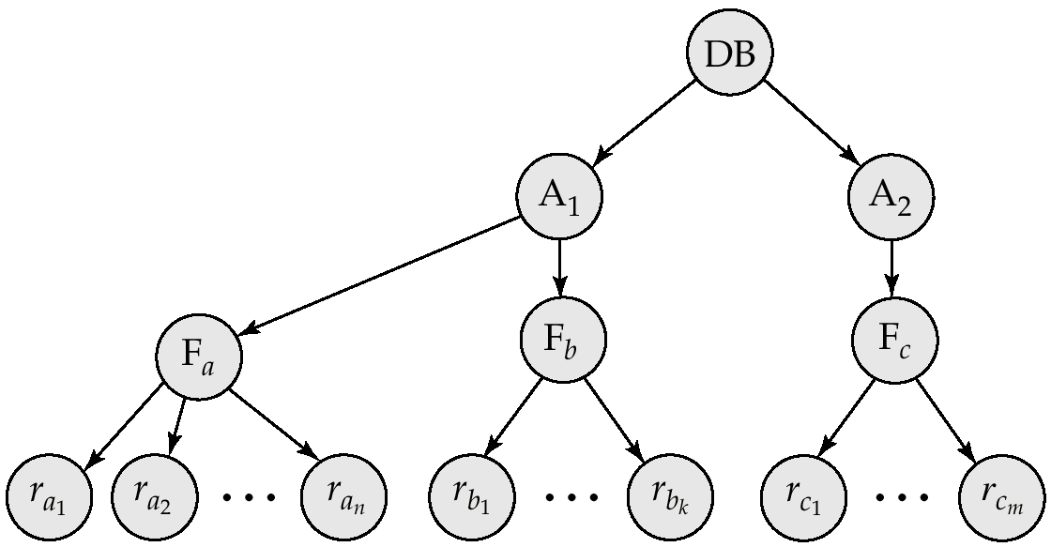
Example of Granularity Hierarchy
The levels, starting from the coarsest (top) level are
database
area
file
record

Slide 21
Intention Lock Modes
In addition to S and X lock modes, there are three additional lock modes with multiple granularity:
intention-shared (IS): indicates explicit locking at a lower level of the tree but only with shared locks.
intention-exclusive (IX): indicates explicit locking at a lower level with exclusive or shared locks
shared and intention-exclusive (SIX): the subtree rooted by that node is locked explicitly in shared mode and explicit locking is being done at a lower level with exclusive-mode locks.
intention locks allow a higher level node to be locked in S or X mode without having to check all descendent nodes.

Slide 22
Compatibility Matrix with Intention Lock Modes
The compatibility matrix for all lock modes is:
IS
IX
S
S IX
X
IS
✓
✓
✓
✓
×
IX
✓
✓
×
×
×
S
✓
×
✓
×
×
S IX
✓
×
×
×
×
X
×
×
×
×
×

Slide 23
Multiple Granularity Locking Scheme
Transaction T_{i} can lock a node Q, using the following rules:
The lock compatibility matrix must be observed.
The root of the tree must be locked first, and may be locked in any mode.
A node Q can be locked by T_{i} in S or IS mode only if the parent of Q is currently locked by T_{i} in either IX or IS mode.
A node Q can be locked by T_{i} in X, SIX, or IX mode only if the parent of Q is currently locked by T_{i} in either IX or SIX mode.
T_{i} can lock a node only if it has not previously unlocked any node (that is, T_{i} is two-phase).
T_{i} can unlock a node Q only if none of the children of Q are currently locked by T_{i}.
Observe that locks are acquired in root-to-leaf order, whereas they are released in leaf-to-root order.

Slide 24
Deadlock Handling
Consider the following two transactions:
T₁: write (X) T₂: write(Y)
write(Y) write(X)
Schedule with deadlock
T₁
T₂
lock-X on X
write (X)
lock-Y on Y
write (Y)
wait for lock-X on X
wait for lock-Y on Y

Slide 25
Deadlock Handling
There are two principle methods for dealing with the deadlock problem:
Deadlock prevention protocols ensure that the system will never enter into a deadlock state.
Deadlock detection and Deadlock Recovery
Allow the system to enter into deadlock
Then try to recover

Slide 26
Deadlock prevention
Deadlock prevention protocols ensure that the system will never enter into a deadlock state. Some prevention strategies :
Require that each transaction locks all its data items before it begins execution (predeclaration).
Impose partial ordering of all data items and require that a transaction can lock data items only in the order specified by the partial order (graph-based protocol).

Slide 27
More Deadlock Prevention Strategies
Following schemes use transaction timestamps for the sake of deadlock prevention
wait-die scheme — non-preemptive
older transaction may wait for younger one to release data item
Younger transactions never wait for older ones; they are rolled back instead
a transaction may die several times before acquiring needed data item
wound-wait scheme — preemptive
older transaction wounds (forces rollback) of younger transaction instead of waiting for it. Younger transactions may wait for older ones.
may be fewer rollbacks than wait-die scheme.

Slide 28
Deadlock prevention (Cont.)
Both in wait-die and in wound-wait schemes, a rolled back transactions is restarted with its original timestamp. Older transactions thus have precedence over newer ones, and starvation is hence avoided.
Timeout-Based Schemes :
a transaction waits for a lock only for a specified amount of time. After that, the wait times out and the transaction is rolled back.
thus deadlocks are not possible
simple to implement; but starvation is possible. Also difficult to determine good value of the timeout interval.

Slide 29
Deadlock Detection
Deadlocks can be described as a wait-for graph, which consists of a pair G = (V,E),
V is a set of vertices (all the transactions in the system)
E is a set of edges; each element is an ordered pair T_{i} →T_{j}.
If T_{i} → T_{j} is in E, then there is a directed edge from T_{i} to T_{j}, implying that T_{i} is waiting for T_{j} to release a data item.
When T_{i} requests a data item currently being held by T_{j}, then the edge T_{i} -> T_{j} is inserted in the wait-for graph. This edge is removed only when T_{j} is no longer holding a data item needed by T_{i}.
The system is in a deadlock state if and only if the wait-for graph has a cycle. Must invoke a deadlock-detection algorithm periodically to look for cycles.

Slide 30
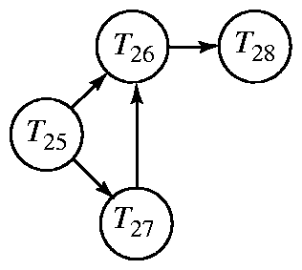
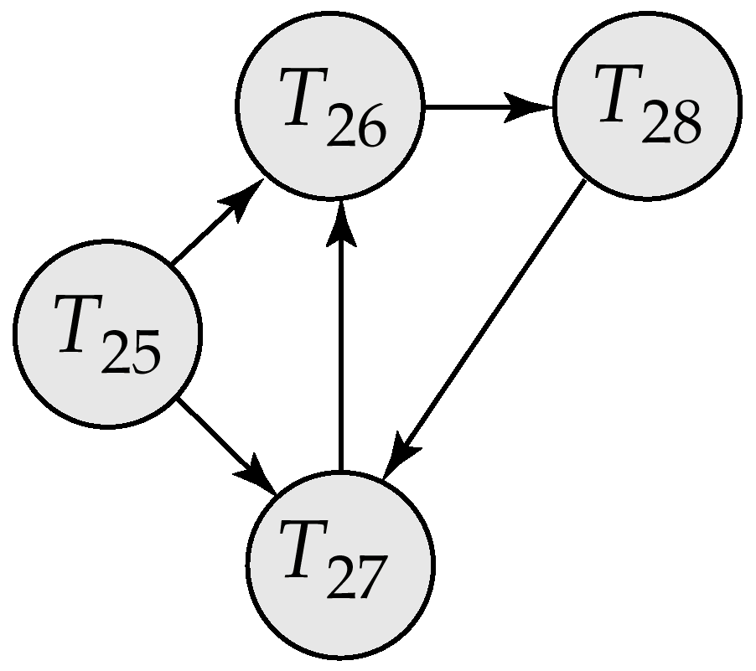
Deadlock Detection (Cont.)
Wait-for graph without a cycle
Wait-for graph with a cycle

Slide 31
Deadlock Recovery
When deadlock is detected :
Selection of victim: Some transaction will have to rolled back (made a victim) to break deadlock. Select that transaction as victim that will incur minimum cost.
Rollback : determine how far to roll back transaction
Total rollback: Abort the transaction and then restart it.
Partial rollback: More effective to roll back transaction only as far as necessary to break deadlock.
Starvation: happens if same transaction is always chosen as victim. Include the number of rollbacks in the cost factor to avoid starvation

Slide 32
Timestamp-Based Protocols
Each transaction is issued a timestamp when it enters the system. If an old transaction T_{i} has time-stamp TS(T_{i}), a new transaction T_{j} is assigned time-stamp TS(T_{j}) such that TS(T_{i}) <TS(T_{j}).
The protocol manages concurrent execution such that the time-stamps determine the serializability order.
In order to assure such behavior, the protocol maintains for each data Q two timestamp values:
W-timestamp(Q) is the largest time-stamp of any transaction that executed write(Q) successfully.
R-timestamp(Q) is the largest time-stamp of any transaction that executed read(Q) successfully.

Slide 33
Timestamp-Based Protocols (Cont)
The timestamp ordering protocol ensures that any conflicting read and write operations are executed in timestamp order.
Suppose a transaction T_{i} issues a read(Q)
If TS(T_{i}) ≤ W-timestamp(Q), then T_{i} needs to read a value of Q that was already overwritten.
Hence, the read operation is rejected, and T_{i} is rolled back.
If TS(T_{i})≥ W-timestamp(Q), then the read operation is executed, and R-timestamp(Q) is set to max(R-timestamp(Q), TS(T_{i})).

Slide 34
Timestamp-Based Protocols (Cont.)
Suppose that transaction T_{i} issues write(Q).
If TS(T_{i}) < R-timestamp(Q), then the value of Q that T_{i} is producing was needed previously, and the system assumed that that value would never be produced.
Hence, the write operation is rejected, and T_{i} is rolled back.
If TS(T_{i}) < W-timestamp(Q), then T_{i} is attempting to write an obsolete value of Q.
Hence, this write operation is rejected, and T_{i} is rolled back.
Otherwise, the write operation is executed, and W-timestamp(Q) is set to TS(T_{i}).

Slide 35
Correctness of Timestamp-Ordering Protocol
The timestamp-ordering protocol guarantees serializability since all the arcs in the precedence graph are of the form:
Thus, there will be no cycles in the precedence graph
Timestamp protocol ensures freedom from deadlock as no transaction ever waits.
But the schedule may not be cascade-free, and may not even be recoverable.
transaction
with smaller
timestamp
transaction
with larger
timestamp

